Slide 1
Interim Project Presentation Tool For Converting Hard Document Into Editable Digital Text Documents Bachelor’s of Technology - Computer Science and Engineering

Slide 2
Group Details
Sl.No. | Reg. No. | Name of the student | Department
1 | 16ETCS002114 | Sarah Zeya Anwar | CSE
2 | 16ETCS002115 | Satyam Agarwal | CSE
3 | 16ETCS002144 | Ashish Kumar | CSE
4 | 16ETCS002161 | Saurav Kumar | CSE
Batch : FT-16

Slide 3
Title of the Project: TOOL FOR CONVERTING HARD DOCUMENT INTO EDITABLE DIGITAL TEXT DOCUMENTS
Supervisors
Supervisor : Ms. Pallavi R Kumar
Place of Work RAMAIAH UNIVERSITY OF APPLIED SCIENCES

Slide 4
Outline
Introduction
Motivation(Project Concept and its relevance)
Aims and Objectives
Title, Aim, Objectives, Methods and Methodology
Problem Solving
Project Concept, Design, Implementation
Project Costing
Expected outcomes
Workload Allocation
Updated Gantt chart with separate coloring for completed work
References
Demonstration (If applicable)
Team Experience

Slide 5
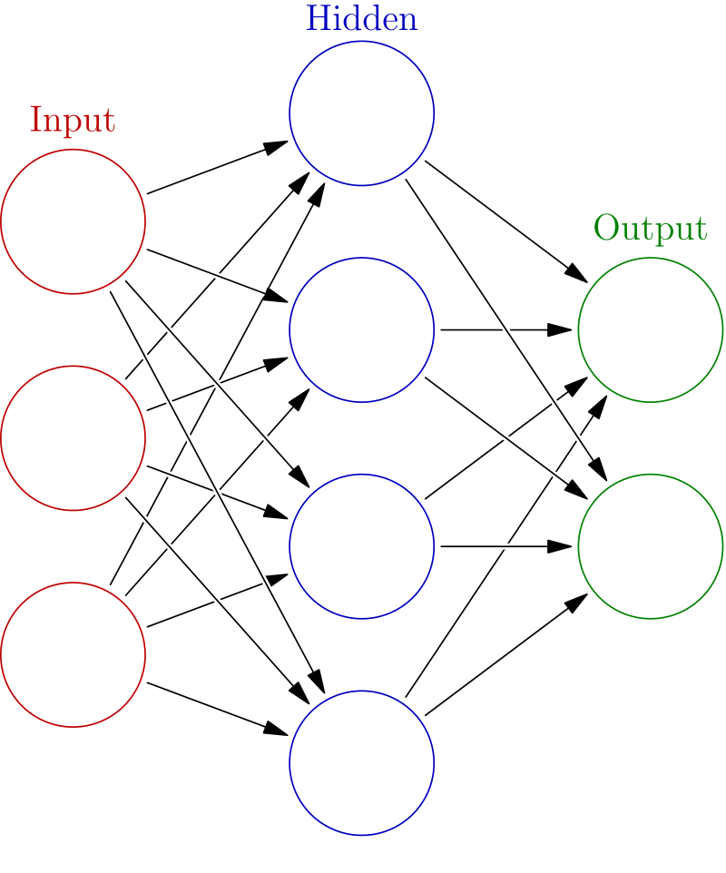
Introduction
Supervised machine learning to convert hard copy of document to digital text document using Image processing and Neural Network.
Artificial neural networks (ANN) are computing systems vaguely inspired by the biological neural networks that constitute animal brains.
Deep learning is part of a broader family of machine learning methods based on learning data representations, as opposed to task-specific algorithms.
Deep learning-based image recognition has become "superhuman", producing more accurate results than human contestants.

Slide 6
Motivation (Project Concept and its relevance)
Earlier, in field of studies and documenting, if someone were presented with a large amount of handwritten text to edit, they would have to input it manually into the computer which is time consuming.
The huge amount of data stored in form of papers in the government offices, case details in courts and police stations etc. become hard to search through and interpret.
These handwritten or printed documents stay in a large pile of pages at workplace and makes the work place messy and put a psychological tension on the person trying to get the data out of those piles.

Slide 7
Motivation (Project Concept and its relevance)
Handwritten notes and important documents are prone to getting lost or destroyed, saving a digital copy is much more efficient and helpful.
This project holds great significance since it aims to assist in easing the conversion from manual to digital text type.
With the help of our tool any amount of handwritten data or printed documented can be turned into digital document.
Process of editing and searching in the documents get easier.
Interpreting the data becomes very easy hence a data which need to very specific can also be obtained without any effort.

Slide 8
PROJECT CONCEPT
Concept of the project is to construct a model which will take handwritten document(image) as input dataset, preprocess the image, train the neural network model from the dataset to recognize the characters and then store the recognized characters into a text document.

Slide 9
Aim
AIM: To develop a tool for conversion of hard copy of document to digital text document.

Slide 10
Objectives
To conduct literature survey on Character Recognition using neural network and textual image processing.
To design the methodology to be followed for developing the text documenting tool.
To develop and implement the algorithm that recognizes a hard text from the image and convert into a digital text document.
To test and validate the developed tool for various textual images.
To document the report by unifying all the results and outcomes.

Slide 11
Methods and Methodologies
Objective 1: Literature Review
Machine Learning in Document Analysis and Recognition
→Summary: The objective of this paper is to understand principal components required for the implementation of a pattern recognition that are pre-processing, object-segmentation, object recognition and post processing in significant details. The paper explores the application of different pattern recognition outputs including handwriting and text recognition.

Slide 12
Literature Review
2. Neural Network based Handwritten Character
Recognition system
→Summary- The effectiveness of their work emphasizes using feature extraction using character geometry and gradient technique from scanned images containing handwritten characters. Their proposed methodology has produced good results for images containing handwritten text written in different styles, size and alignment.

Slide 13
Method and Methodology Contd..
Objective 2: Design
Assumptions
The input image is assumed to contain only English characters.
The input image is assumed to be a text written on un-ruled white paper.
The input image is assumed to contain text that are not cursive.
The input image is assumed to contain text that does not contain noise e.g. Ashish .

Slide 14
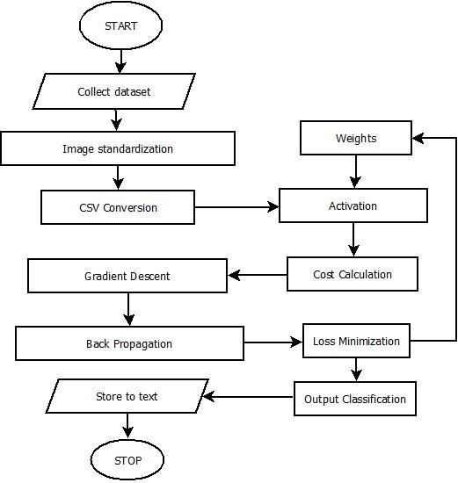
Design - Flowchart

Slide 15
Method and methodology contd..
Objective 3: Implementation
We are using NIST dataset for the implementation which includes about 800,000 image data of characters.
The assumptions are made to develop a better classifier as the we have dataset limited to English characters and digits only.
To process the computation we are taking the help of google colaboratory as they provide free GPU and TPU processing.

Slide 16
Method and methodology contd..
Objective 4: Testing and validation
Collecting various test samples for the input.
Conducting unit testing and system testing.
Conducting validation check of the tool.
Checking the performance of the tool for test inputs.

Slide 17
Method and methodology contd..
Objective 5: Documentation
Based on the literature survey done, the requirements are reported.
Demonstration of the developed algorithm with the test data will be reported.
After the design, implementation, verification, testing and validation, results of the system are reported.
Analyze performance of the tool and report the performance test’ results.

Slide 18
Expected Outcomes
Demonstration of Working Model
Tool

Slide 19
Project Costing
Component | Units | Cost
Man power | 16weeks*4people | ₹2,00,0000
Laptop (Hardware and software) | 4 Units | ₹10,000
Internet and Electricity | 4 | ₹5,000
Total |  | ₹2,15,000

Slide 20
Work Load Allocation
 | Saurav K | Satyam A | Ashish K | Sarah Anwar
Literature Survey
Documentation
Requirements analysis
Designing
Implementation
Testing

Slide 21
Updated Gantt Chart
Project Work (UG) 16weeks
Week | 1 | 2 | 3 | 4 | 5 | 6 | 7 | 8 | 9 | 10 | 11 | 12 | 13 | 14 | 15 | 16
Major Activities
Project Selection
Literature survey
Design
Implementati-on
Testing
Documentati-on

Slide 22
References
Attigeri, S. (2018). Neural Network based Handwritten Character Recognition system. International Journal of Engineering and Computer Science, 7(03), 23761-23768.
LeCun, Y., Jackel, L.D., Bottou, L., Cortes, C., Denker, J.S., Drucker, H., Guyon, I., Muller, U.A., Sackinger, E., Simard, P. and Vapnik, V., 1995. Learning algorithms for classification: A comparison on handwritten digit recognition. Neural networks: the statistical mechanics perspective, 261, p.276.

Slide 23
References
Simone Marinai, Hiromichi Fujisawa.Machine Learning in Document Analysis and Recognition, 2008 Springer-Verlag Berlin Heidelberg.

Slide 24
Team Experience
We have learnt and explored our experience on this group project which includes analyzing, researching, documenting and implementing.
Sharing and discussing different ideas and amount of knowledge amongst the group gave us a brief insight on how to deal with problems and come up with an applicable solution.
We experienced how to confront difficulties in a team work and how to resolve any sort of argument or problem by coming up with something which is agreeable by everyone.

Slide 25
Team Experience
While working on project such as this, we exercised a great opportunity of developing and enhancing our technical skills effectively and efficiently.
We have also acquired different set of skills from each other that is beneficial to each one of us in the long run.
In conclusion, We’ve learnt a lot of things about ourselves while working with our group members in undertaking this project.

Slide 26
Thank You

